Slide 1
OOPs Concepts

Slide 2
Version Control and Revision History
 | Name | Date
Prepared By | Paranthaman | 09-07-2019
Reviewed By | Team | 09-07-2019
Approved By | Team | 09-07-2019
Version No. | Date | Affected Sections | Highlights
2.0.0 |  | ALL | Updated Based on the course sheet coverage

Slide 3








Iconic Representations.......
Test your Memory
Can you Solve?
Objective
Coffee Break
Queries
Recap
Need more Info
Brainstorm

Slide 4
Objectives
At the end of this module you would be able to understand
Class and Object
GC
Constructor
Local and Static block
Access Specifiers
Notes:
Variables:
A variable is a location in your computer's memory(Random Access Memory (RAM)) in which you can store a value and from which you can later retrieve that value.
A variable must always be defined inside a Java class.
When you define a variable in Java, you must tell the compiler what kind of variable it is. (this is usually referred to as variable type).
Types of Variables :
Class Variable/Static variable
A java class variable is a field declared using the keyword static within a java class, or with or without the keyword static within a java interface declaration.
These variables are declared at the top level. They begins their life when first class loaded into memory and ends when class is unloaded. As they remain in memory till class exist, so these variables often called Class variables.
There only one copy of these variables exist
These variables are having highest scope that is they can be accessed from any method/ block in a class
When no explicit assignment made while declaration they are initialized to default values , depending on their type.

Slide 5
Class and Object
Classes :
A class is nothing but a blueprint or a template for creating different objects which defines its properties and behaviors.
A class can define the properties and behaviors of the particular type of object to used/be created in the program.
Objects:
An object is an instance of a class created using a new operator.
The new operator returns a reference to a new instance of a class.
This reference can be assigned to a reference variable of the class.
The process of creating objects from a class is called instantiation. An object encapsulates state and behavior.
Object can be initialized by calling constructor method.
The phases of life of an Object are:
Creating Object.
Using Object.
Cleaning Up Unused Object done by GC.

Slide 6
Class and Object(Contd.)
Creating Object:
It includes Declaration, Instantiation and Initialization
Declaring an Object is just like variable declaration
The new operator instantiates a class by allocating memory for a new object of that type.
classes can provide one or more constructors to initialize a new object of that type.
Using Object
We can use an Object to
1. Manipulate or inspect its variables
2. Call Methods of that class.
Objects can refer to members using dot(.) operator.
Cleaning Up Unused Object
The Java runtime environment deletes objects when it determines that they are no longer being used. This process is called garbage collection.

Slide 7
Class and Object(Contd.)
Cleaning Up Unused Object
An object is eligible for garbage collection when there are no more references to that object. References that are held in a variable are naturally dropped when the variable goes out of scope. Or you can explicitly drop an object reference by setting the variable to null.
The Garbage Collector
The Java platform has a garbage collector that periodically frees the memory used by objects that are no longer needed.
The Java garbage collector is a mark-sweep garbage collector. A mark-sweep garbage collector scans dynamic memory areas for objects and marks those that are referenced. After all possible paths to objects are investigated, unmarked objects (unreferenced objects) are known to be garbage and are collected.
The garbage collector runs in a low-priority thread and runs either synchronously or asynchronously depending on the situation and the system on which Java is running.
It runs synchronously when the system runs out of memory or in response to a request from a Java program.
The Java garbage collector runs asynchronously when the system is idle

Slide 8
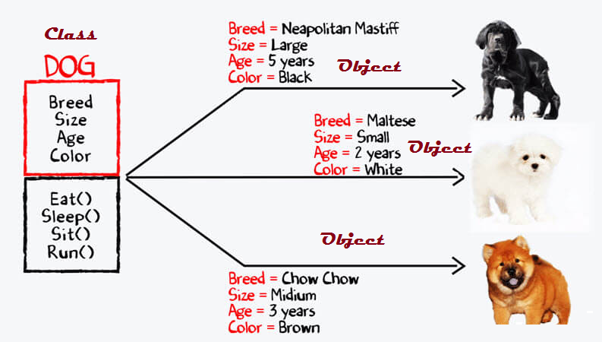
Example for Class and Object (Contd.)
This is class
They are data
There are members

Slide 9
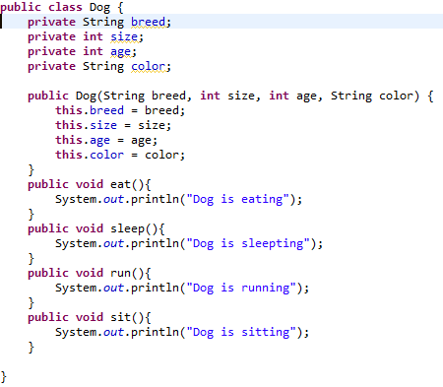
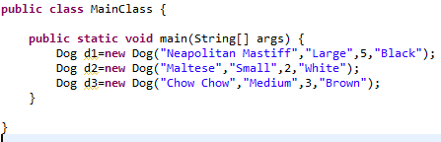
Coding for Class and Object (Contd.)

Slide 10
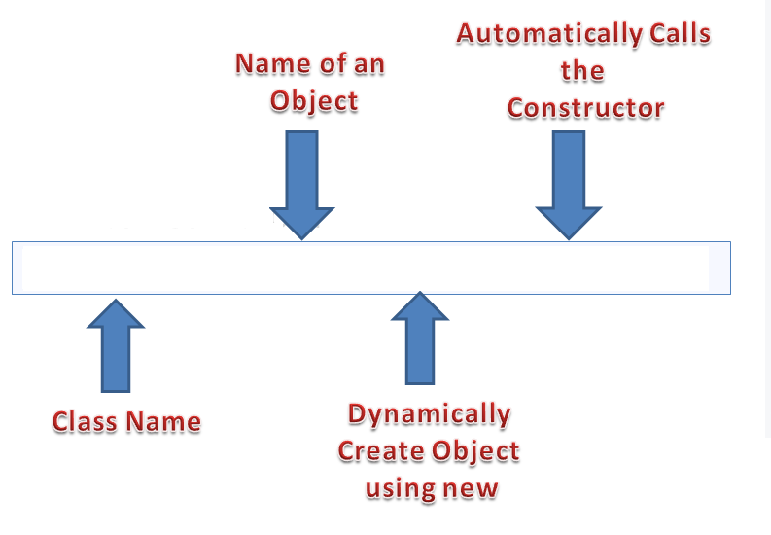
Object
Dog doggy=new Dog();

Slide 11
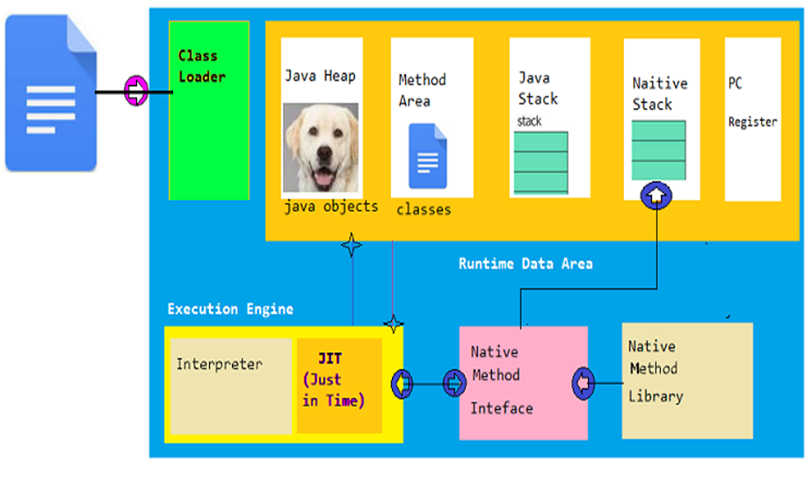
Memory Blocks in JAVA
Dog.class

Slide 12
Garbage Collection
Cleaning Up Unused Object
Before an object gets garbage-collected, the garbage collector gives the object an opportunity to clean up after itself through a call to the object's finalize method. This process is known as finalization.
During finalization, an object may wish to free system resources such as files and sockets or to drop references to other objects so that they in turn become eligible for garbage collection.
The finalize method is a member of the Object class.
Syntax:
protected void finalize()
{
// finalization code here
}

Slide 13
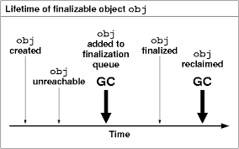
Object Life Time

Slide 14
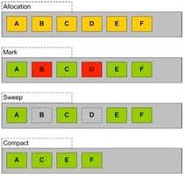
Language Fundamentals
Objects(Contd..)
Garbage Collector(Contd..)
Allocation
Mark
Sweep
Compact

Slide 15
Constructor in Java
Class contains Constructor which is a method that are invoked to create object
It is used to initialize the instance members of the object
Name of the constructor is same name of the Class
Cannot have return type
Can be overloaded
Constructor can call another constructor through this keyword.

Slide 16
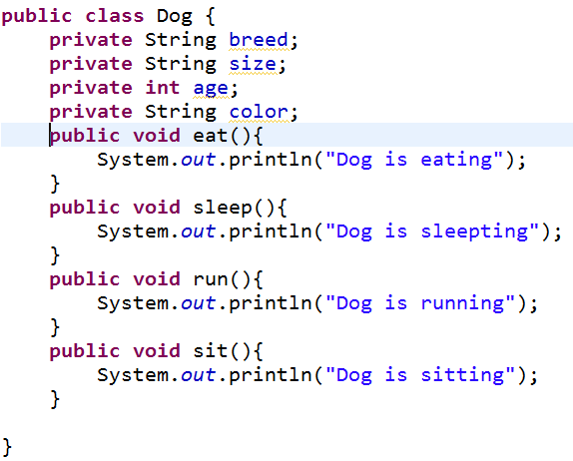
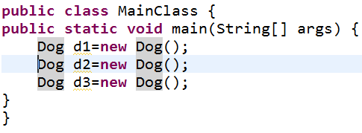
Default Constructor
If class do not have any constructor explicitly, JVM will add the Default constructor in the class automatically.

Slide 17
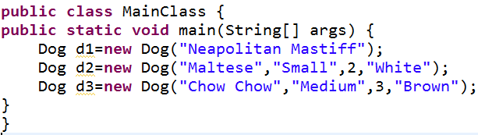
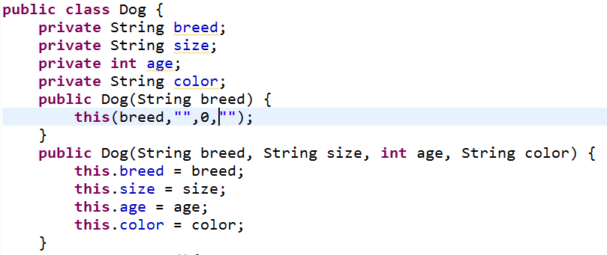
Parameterized Constructor

Slide 18
Local Block and Static Block
A static initialization block is a normal block of code enclosed in braces, { }, and preceded by the static keyword
Executed only once after class is loaded
static {
// whatever code is needed for initialization goes here
}
Local Block or Initializer blocks is an alternative to using a constructor to initialize instance variables.
Executed whenever instance of the class is created.
{
// whatever code is needed for initialization goes here
}

Slide 19
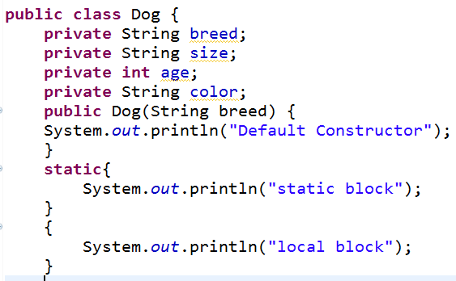

Local Block and Static Block
Default constructor
Static Block
Local Block

Slide 20
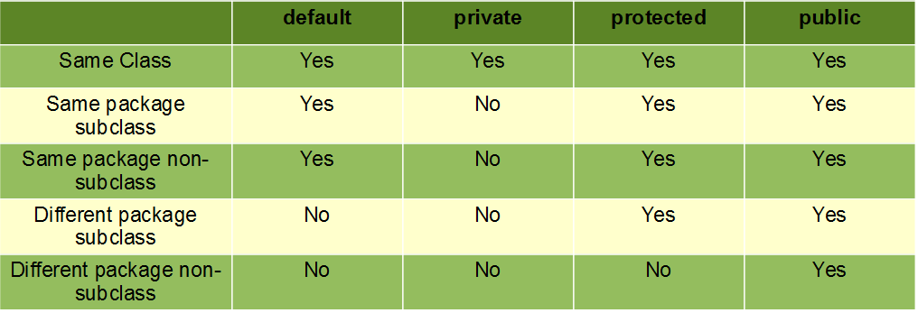
Access Specifiers
Java allows you to control access to classes, methods, and fields via so-called access Specifiers.
Java supports four access- Specifiers
public
protected
default
private
Visibility

